Slide 1

Engin Turkmen Predict the attrition in the company and Uncover the Factors that lead the employee attrition January 28, 2019

Slide 2

Problem Definition
Why? & Predict?

Slide 3


Data Information
1470 Observations & 35 Features

Slide 4

Data Information
Attrition
237 / 1470
Non-Attrition
1233 / 1470
Imbalanced Classification Problem

Slide 5
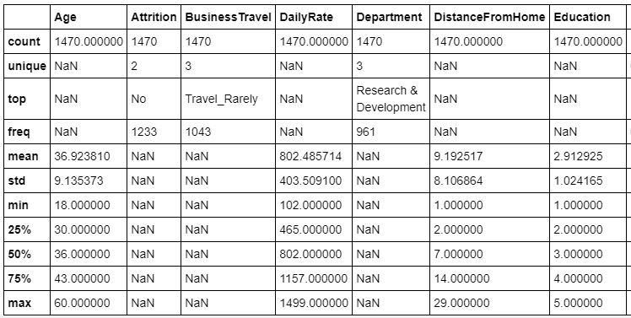
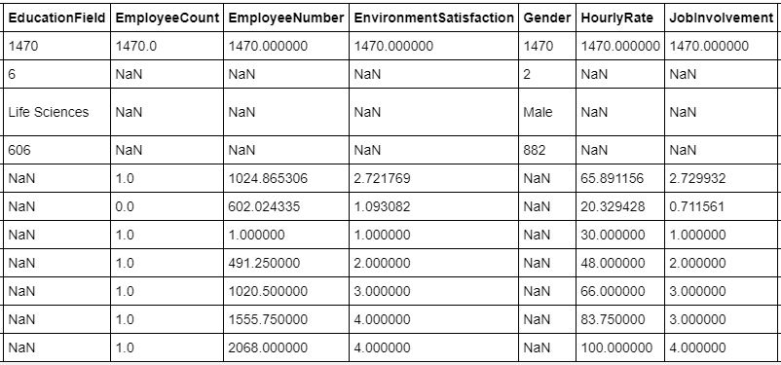
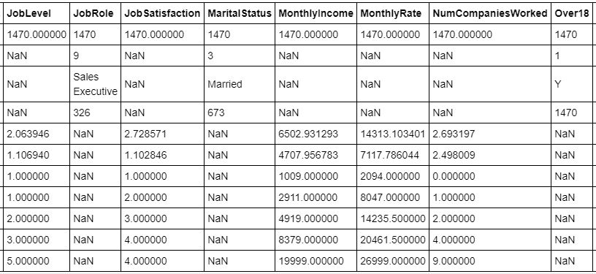
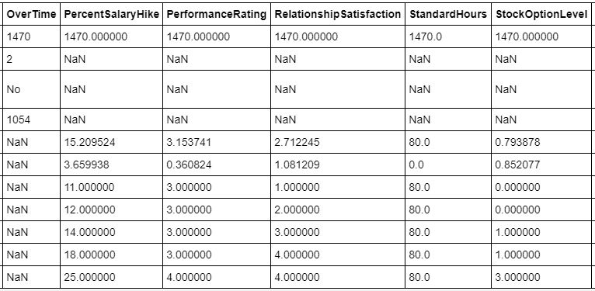
Data Information

Slide 6
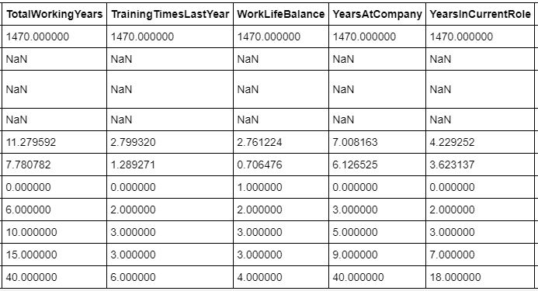
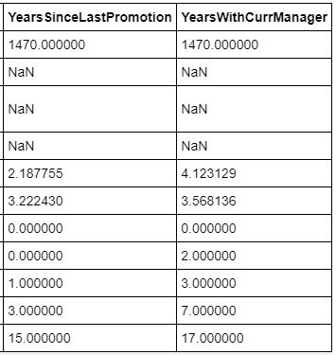
Data Information

Slide 7
Feature Engineering
Missing Values
Decide what features to keep
Feature Types
Transform Categorical Data into Numeric

Slide 8
Exploratory Data Analysis

Slide 9
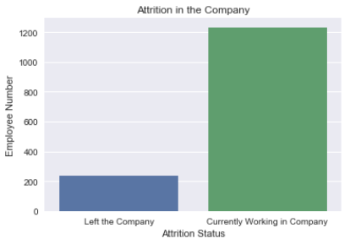
Target Variable (Attrition)

Slide 10
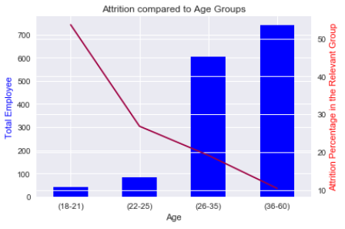
Age

Slide 11
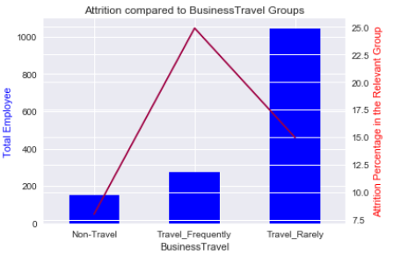
Business Travel

Slide 12
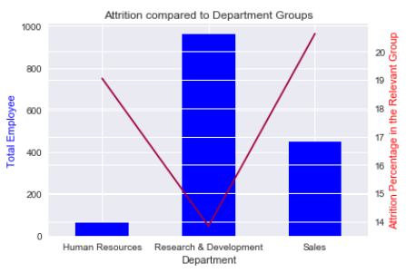
Department

Slide 13
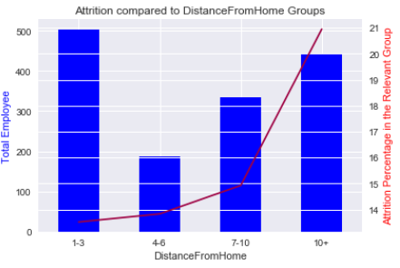
Distance From Home

Slide 14
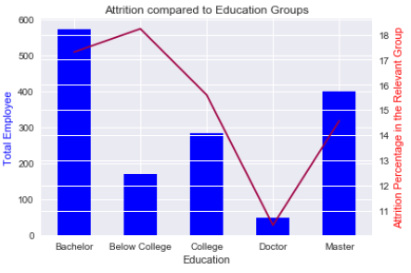
Education

Slide 15
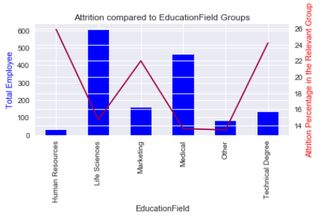
Education Field

Slide 16
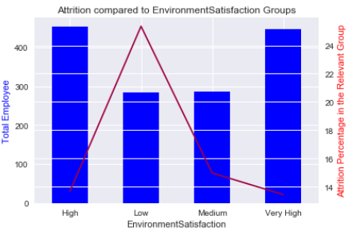
Environment Satisfaction

Slide 17
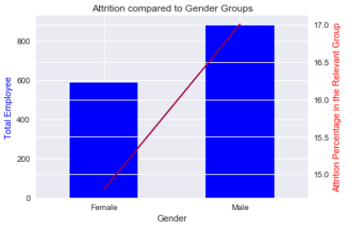
Gender

Slide 18
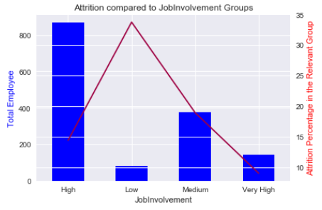
Job Involvement

Slide 19
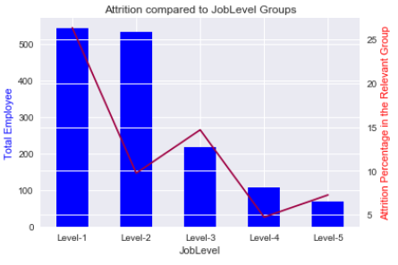
Job Level

Slide 20
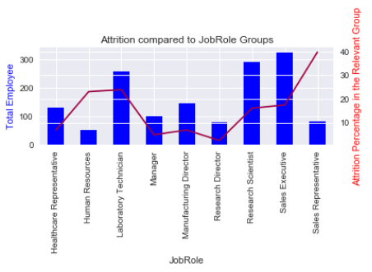
Job Role

Slide 21
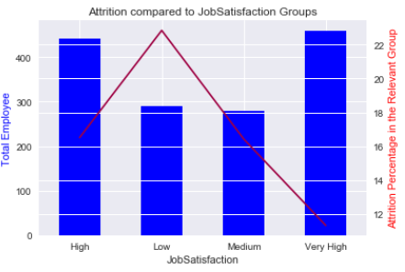
Job Satisfaction

Slide 22
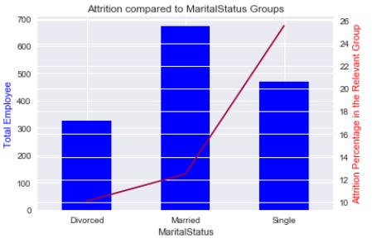
Marital Status

Slide 23
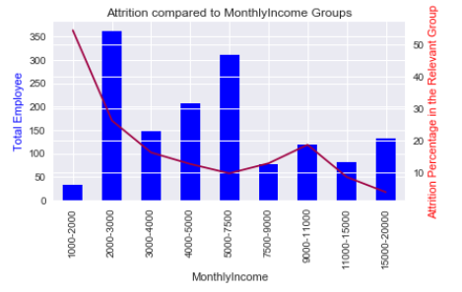
Monthly Income

Slide 24
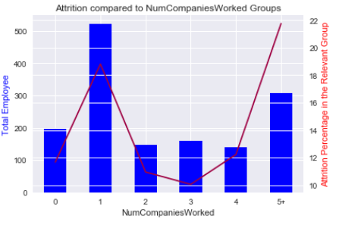
Numbers Companies Worked

Slide 25
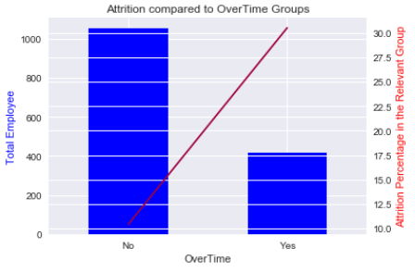
Over Time

Slide 26
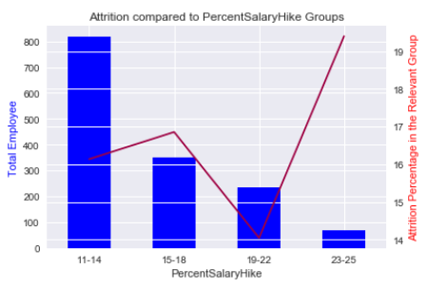
Percent Salary Hike

Slide 27
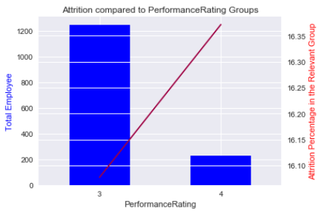
Performance Rating

Slide 28
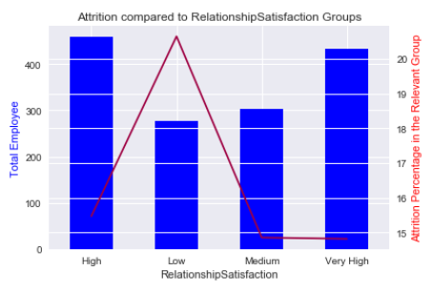
Relationship Satisfaction

Slide 29
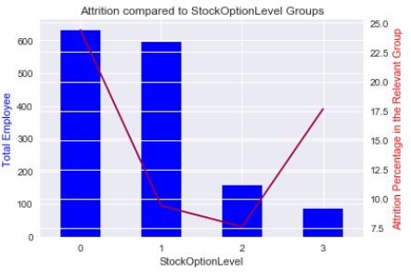
Stock Option Level

Slide 30
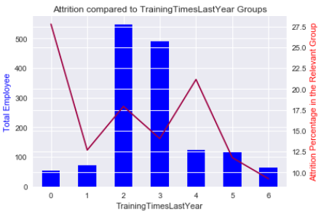
Total Working Years

Slide 31
Training Times Last Year

Slide 32
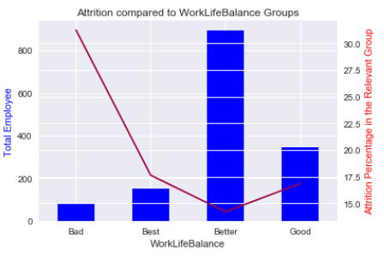
Work Life Balance

Slide 33
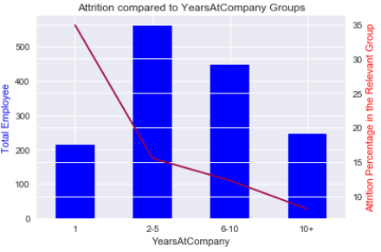
Years at Company

Slide 34
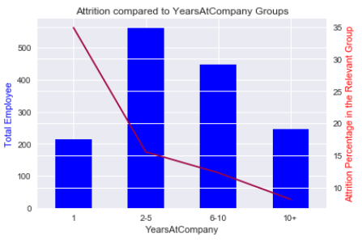
Years in Current Role

Slide 35
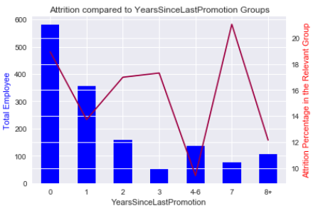
Years Since Last Promotion

Slide 36
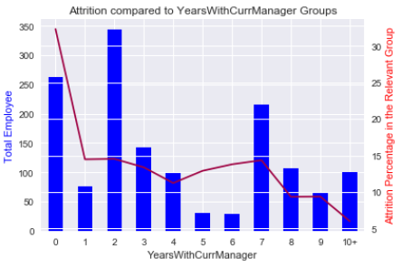
Years with Current Manager

Slide 37
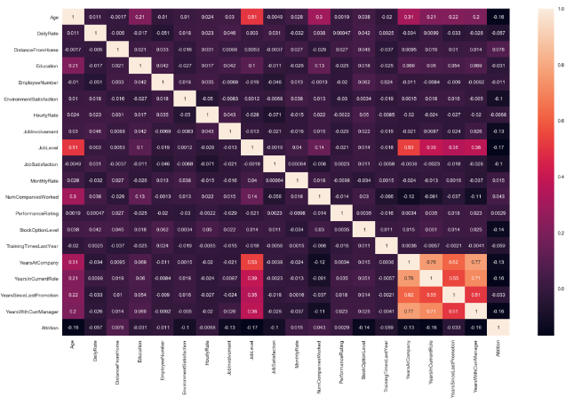
Correlation Matrix

Slide 38
Hypothesis Testing

Slide 39
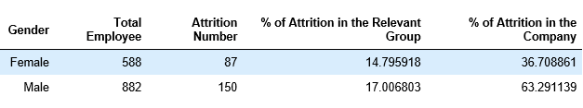
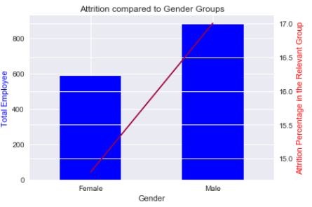
Examining Attrition in Gender

Slide 40
The Null and Alternate Hypotheses
Null Hypothesis: There is no difference in the proportion of attrition for male and female employees in the company.
Ho : p̂ male_attrition − p̂ female_attrition = 0
Alternative Hypothesis: There is a significant difference in the proportion of attrition for male and female employees in the company.
Ha : p̂ male_attrition − p̂ female_attrition ≠ 0
Significance Level: 95% Confidence

Slide 41
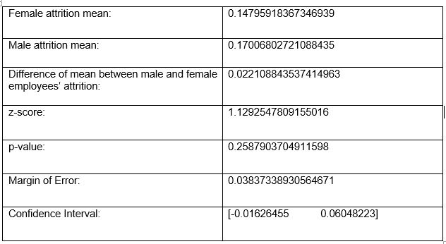
The Frequentist Statistical Approach
Fail to Reject Null Hypotheses!

Slide 42
Machine Learning

Slide 43
Data Preprocessing
Separate response variable and features
Splitting the dataset into the Training set and Test set
Handling Imbalanced Dataset
Feature Scaling

Slide 44
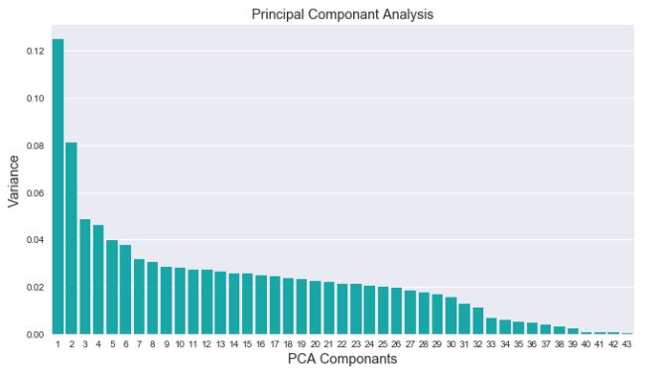
Data Preprocessing
Principal
Component
Analysis
90% explained by 27 features

Slide 45

Selecting the Right Evaluation Metric
f1 score

Slide 46

Applying Machine Learning Algorithms
Logistic Regression
All Features
Decision Tree Classification
Random Forest Classification
K-NN Classification
SVM Classification
PCA Features
Kernel SVM Classification
Naïve Bayes Classification
Gradient Boosting Classification
Hyperparameter Tuning
Ada Boost Classification

Slide 47
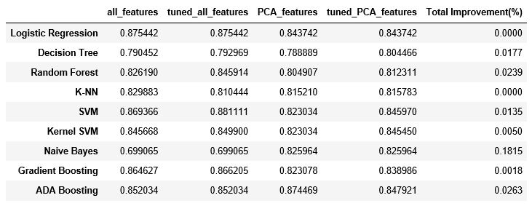
Model Comparison

Slide 48
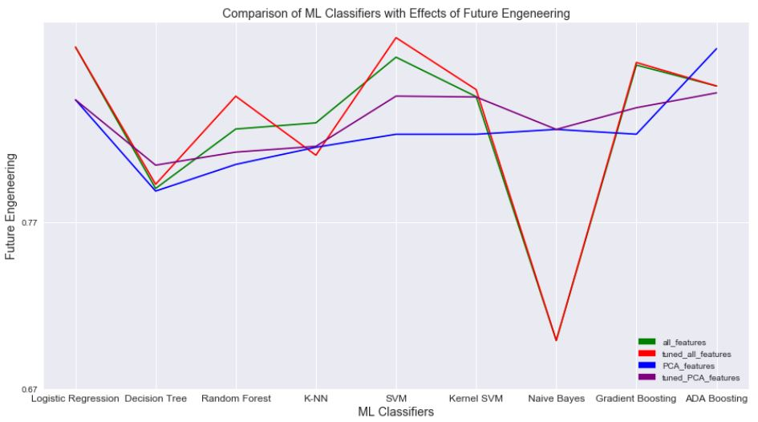
Model Comparison

Slide 49

Handling Target Class Imbalance
No improvement on f1 score

Slide 50
Conclusion

Slide 51
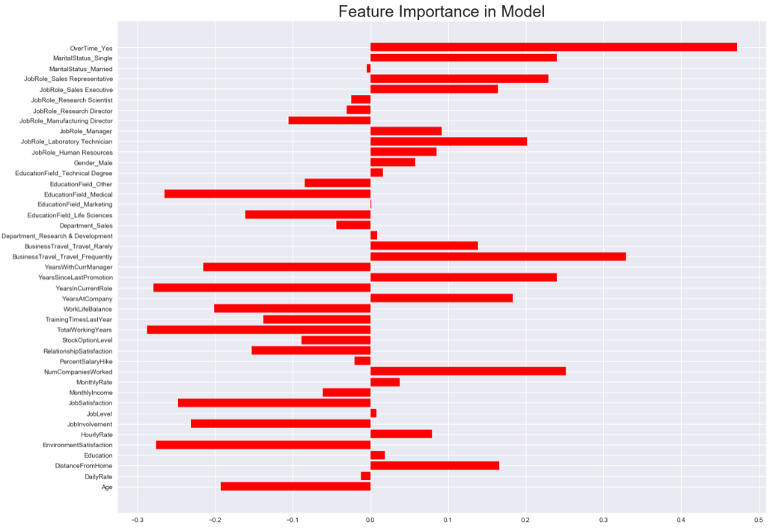
Most Important Features
Total working years,
Years in current role,
Environment satisfaction,
Medical education field,
Job satisfaction,
Job involvement,
Years with current manager,
Work life balance,
Age
Overtime,
Business travel,
Numbers of companies worked
status,
Marital status,
Years since last promotion,
Job role status

Slide 52
Recommendations
* 28.3% of employees have over time work in the company and 30.5% of those employees leave the company. As it is also reflected in the model, employees working overtime are significantly more likely to resign. Therefore, the company should understand the reason why they are working overtime. Is it for too high workload or are employees' qualifications not enough to complete the scheduled tasks on time? Maybe there might be some other reasons behind that. Our recommendation will be to understand the reason(s) for overtime with detail research and take appropriate measures to reduce the factors behind this attrition factor.

Slide 53
Recommendations
* 18.8% of the employees travels frequently, and they have the highest attrition percentage(25%). The company should question what makes traveling a burden on their employees. The company should balance the travel status and if necessary, there might be some adjustments on the job description in terms of traveling. The company may use some extra incentives to motivate their employees who are supposed to travel.

Slide 54
Recommendations
* 21% of employees worked in 5 and more companies before this company and have 21.8% attrition. This is an area where HR should be aware of. HR should question the employee candidate why the employee quits the previous job and get in touch with previous company to have information about the applying employees. Besides that, the company should take precautionary measurements to keep their employees in their current role after they hire new employees.

Slide 55
Recommendations
* 32% of employees are single and has the highest attrition percentage(25.5%). The company should be aware of this important factor and have strategy to deal with this groups' performance.

Slide 56
Recommendations
* If the year increases since the employees' last promotion, the attrition percentage also displays increase. Especially, 7 years since last promotion employee group (5.2%) has the highest attrition(21.1%) in its individual group. For that reason, the company review their promotion policy, and maybe define the company's expectations from their employees and make clear to all employees how and when they may be promoted.

Slide 57
Recommendations
* 5.6% of employees works as Sales Representative and 17.6% of employees works as Laboratory Technician. They have 39.8% and 17.6% attrition percentage respectively. These two-job roles should be questioned, and the company should find the reason(s) why these job roles face more attrition rate than all others and take necessary actions.

Slide 58
Recommendations
* There are some other indicators which keep employees in the company. These factors are stated below.
- Total working years in the company,
- Years in current role,
- Environment satisfaction,
- Medical education field,
- Job satisfaction,
- Job involvement,
- Years with current manager,
- Work life balance,
- Age.
The company should primarily try to increase the effectiveness of those factors. As a result, it will yield to the decrease in the attrition rate.

Slide 59
Next Steps to Improve Model
* In our model, we have only 1470 observations from the company, which is poor to create a strong machine learning algorithm in order to predict the attrition beforehand and act depending on this prediction. For that reason, we need to have more data from the company to improve our model's prediction accuracy.

Slide 60
Next Steps to Improve Model
* There are couple of ways to do that.
- The company should prepare a well-designed survey for the employees who leave the company. According to those survey's result, they may create other feature(s) for their data, which will enable to improve model accuracy.
- Besides that, the company should also prepare surveys for the employees who stay longer in the company since they should be aware of what makes the them to work longer in the company.

Slide 61
Next Steps to Improve Model
* There are couple of ways to do that.
- The company should take random/immediate surveys whenever they come across a problem area in terms of human resources.
- The company apply regular surveys to see the trend in the company. For example, once in a month, twice in a year, etc.

Slide 62
Next Steps to Improve Model
* We can do more permutations & combinations, feature engineering, feature selection, hyper-parameters tuning, class imbalance, etc. to improve the accuracy score. But this won't make so much difference in the accuracy score at hand now. Modelling improvement depends more on the increase in the observation quantity. Namely, the company should focus on more to collect the reasonable data from their employees.

Slide 63
End of the Presentation

